Slide 1
LENDING CLUB CASE STUDY SUBMISSION
January 20 2025
Ratnam Punukollu

Slide 2
Lending Club Case Study Abstract
Lending Club is a marketplace for personal loans that matches borrowers who are seeking a loan with investors looking to lend money and make a return. When the company receives a loan application, the company has to make a decision for loan approval based on the applicant’s profile. Two types of risks are associated with the bank’s decision:
If the applicant is likely to repay the loan, then not approving the loan results in a loss of business to the company
If the applicant is not likely to repay the loan, i.e., he/she is likely to default, then approving the loan may lead to a financial loss for the company.
The task of the case study is to Identify these risky loan applicants, then such loans can be reduced thereby cutting down the amount of credit loss. Identification of such applicant's using EDA is the aim of this case study.
To complete the case study, we have been given an applicant pool of 40,000 with several parameters in addition to 100+ fields. The data includes several pre loan and post loan parameters for analysis
The approach towards data analysis is provided below
Approach towards data analysis
Load Required Libraries
Review of Data Frame Characteristics and Types
Fix Data Type as Required for Analysis
Evaluation of Missing Values and Data Discrepancies
Apply Appropriate Data Cleansing and Imputation Measures
Eliminate Variables Not Needed
(Customer Behavioral Variables)
Conclusions and Recommendations
Bi Variate Analysis
Segmented Univariate Analysis
Data Analysis
Univariate Analysis

Slide 3
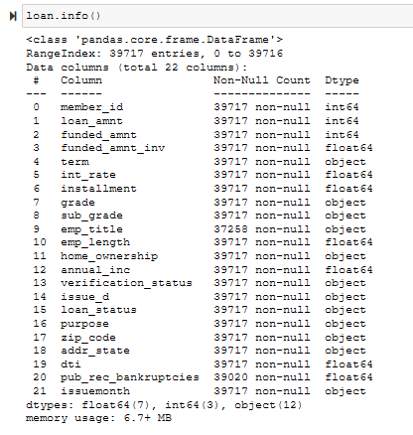
Data Cleaning
Data Cleansing and Review: Partial Representation
Upon observation of over 39000 rows and 111 columns, there appear to be several (50+) columns with null values.
55 columns have 100% null values, after inspecting actual values available.
Columns having >75% missing values can be dropped
Post dropping of columns with null values ,removal of customer behavior variables and columns with single unique values, we have reduced variable count to 21 with over 39000 observations
Some variable data types have been changed to support analysis, similarly, we added a derived columns and removed special characters from some variables to support the analysis
A few categorical variables have been added to segment the numeric variables into groups for better analysis
The final data is being subset for loan statuses that cover the scenarios for fully paid and charged off cases to evaluate the key drivers for charge offs. The current loan pool is dropped as it does not facilitate with the evaluation.

Slide 4
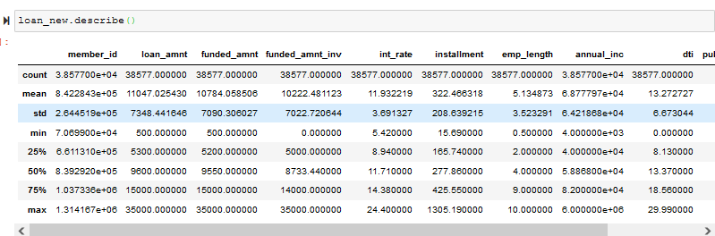
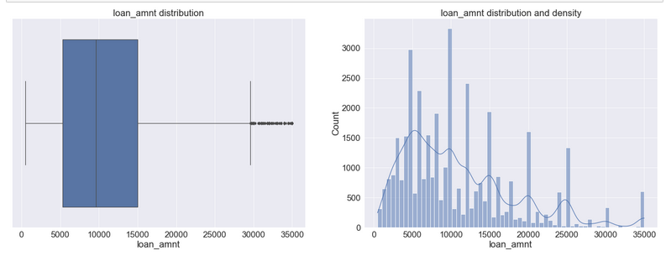
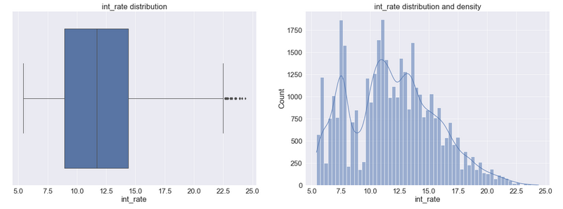
Data Understanding
Numeric Variable Interpretation: Partial Representation
Loan amnt, funded amnt, funded amnt inv are close in terms of mean and median values
The median is consistently lower than the mean for the loan amnt and the other two funded amnt categories
implying there is an effect of outliers driving the mean higher.
The annual Income field also displays the same behavior and might have outliers increasing the mean
The interest rate median and mean are close indicating a normally distributed sample without many outliers

Slide 5

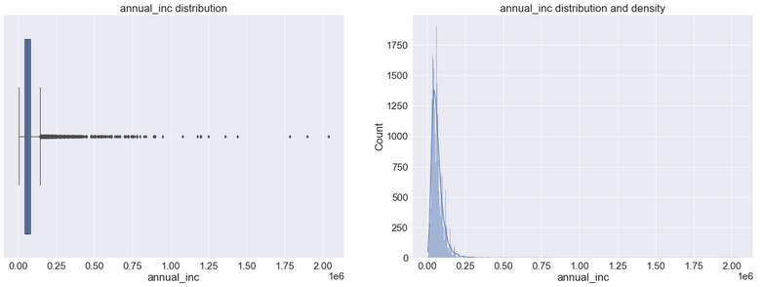
Univariate Analysis Summary (1/2)
Numeric Variable Interpretation: Partial Representation
Loan Amount: Median loan amount application is 10K. 75% of values lie under 15K. We do notice outliers beyond 30K. Right skewed distribution with mean around 11K
Interest Rate: Median interest rate for an application is 11.7%. 75% of values lie under 14.3%. We do notice outliers beyond 20.5% up to 24%. The top 25% is in the 8.9% range. The high variability indicates the variability in risk associated with the loans and the influence of the loan term (we will verify this during our bivariate analysis). Right skewed distribution with mean around 11.9%
Employee Length: Emp length category 10 is an aggregate category of employees > 10 years of work experience. Hence could be overstated. The numeric categorical variable is highest for above 10 years followed by 0 - 1 yrs. combined. It is perhaps the membership profile of the lending club which is skewed towards young employees or older ones.
Variables to be converted to categorical for further analysis: a)annual_inc b) emp_length c) int_rate and d) loan_amnt

Slide 6
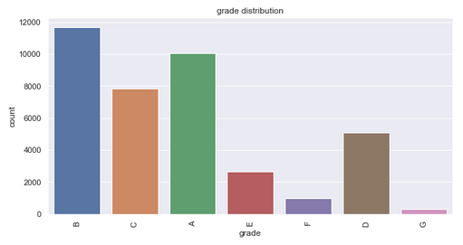
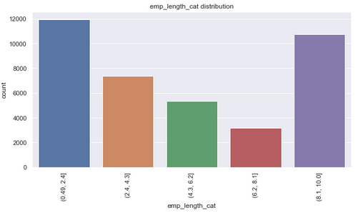
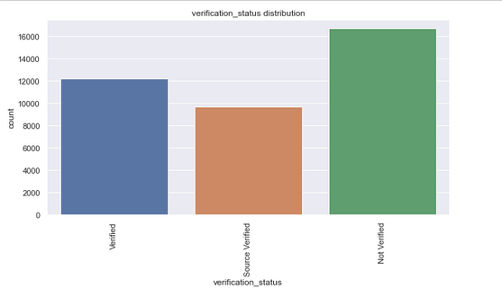
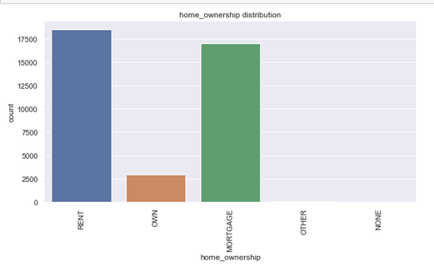
Univariate Analysis Summary (2/2)
Categorical Variable Interpretation: Partial Representation
Top quality loan applicants are relatively fewer than the B grade applicants. There is a further gradation of the grades into sub grades displaying no specific pattern of occurrence as such
A large chunk of the loan applications appear to be in the unverified status and represents risk of posing data quality and reliability of loan data to accurately evaluate members ability to pay up the loan
Top loan accounts originate from well known progressive states such as CA, NY, FL, TX with larger degree of urbanization, tax rates and higher than average income levels.
We segmented loan amount under 5 categories to understand the need. Appeared like the sub 7400 loans constituted about 37% of the hand outs and the second tier contributed to another 30+ %
We segmented interest rate under 5 categories and observed about 25% of the loans being given at lower interest rates, the second tier between 9 and 13% loans were the second highest representing about 37% of the loans given. In

Slide 7
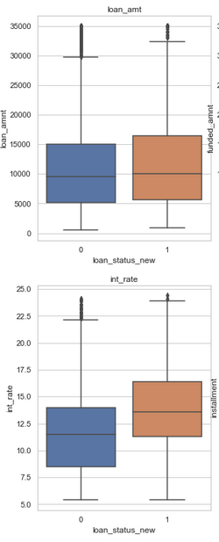
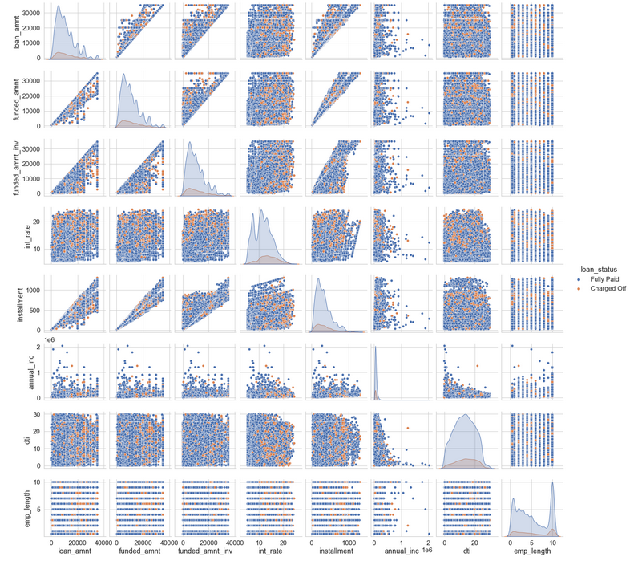
Bivariate Analysis Summary (1/2)
Numeric Variable Interpretation: Partial Representation
We find similar number of defaulters based on the loan status fully paid relative to loan amount except that there is a slightly higher default above 15K. The threshold is slightly lower for amount funded by investors if looking at actual disbursements vs. defaults this stands at 14.5K approximately
The median for defaulters in terms of interest rate is higher. There is an elevated chance of default over 14%
The median values and the 75th percentile range for fully paid and defaulters appears to be similar. Given the percentage mix of data(imbalanced) we can infer that the higher income levels have lower propensity to default with a few exceptions.
We have observed in general multiple bankruptcies indicate higher chance for default
Loan amt vs. int rate - No clear pattern observed in the pair plot for default rate. However, in the in the interest rate KDE we can observe the area of default is larger when the interest rate goes up.
Lower interest rate with lower annual incomes have a lower default same is the case with lower interest rate and lower DTI
As the loan amount increases, there is an increase installment. Lesser defaults observed for higher installments
Low annual income and high interest rates mean higher defaults
The correlations analyzed in general aren't strong between the independent variables.

Slide 8
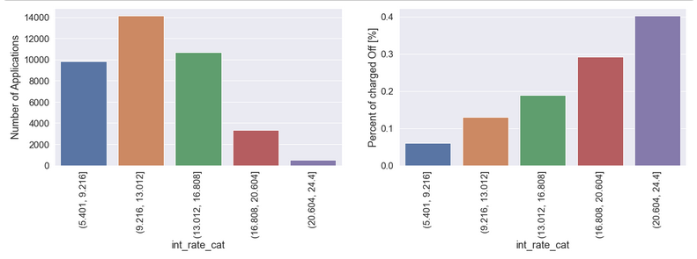
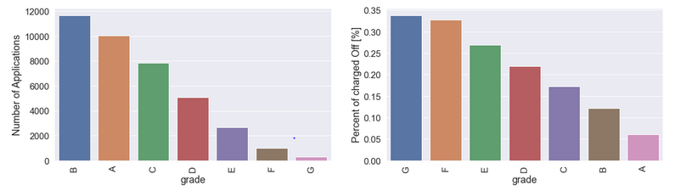
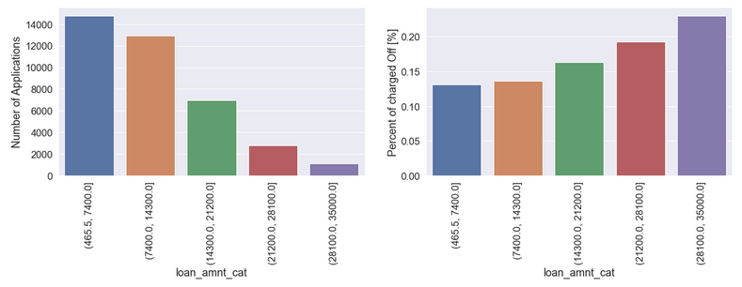
Bivariate Analysis Summary (2/2)
Categorical Variable Interpretation: Partial Representation
Higher interest rates are clearly contributing to higher percentage of charge offs on lower loan pools (number of applicants).
The lower investment grades have a higher charge off percentage. This shows that the investment grades are quite accurate as a predictor of loan default. This is also good from a lending club product standpoint that they are able to attract the right mix of loan grades
We segmented the loan amount into 5 categories. Higher the loan amount, smaller the loan pool greater the default risk. Capping the loan amounts < 20K can potentially reduce default risk
Not verified constitutes about 40% of the loan pool representing 12.5% of charge offs addressing these could help arrest the default risk categories.
We segmented the annual income into 5 categories. The default risk is slightly lower as the income level goes up. That said the applicant loan pool is equally spread out among all categories (lending club customer base) The risk of default threshold between income levels is mildly influential at 7.5% ( 17.5% - 10% at highest income bracket)
From the data it is clear that though the volume of applicants with public record of bankruptcies is low, there is a strong propensity for default based on the bankruptcy record of the applicant. lending club can stop providing loans to such members.
The default rate pattern from a few states is high. Lending club could scrutinize applications from specific state and zip code combinations further. While NE has high default rate. relative to loan volume, it isn't significant. Where has the top 5 high volume states could be further analyzed which have an average of 15% default rate (for e.g., CA)

Slide 9
Conclusions and Recommendations
MAJOR FACTOR INFLUENCING CHARGE OFF’s*
Interest rate
Loan amount
Annual income
Public record of bankruptcies
Verification status is unverified
Home ownership status of others, rent and mortgage
Grade: lower grade tend to have higher default
Term
Top 5 states of applicant pool
Purpose
RECOMMENDATIONS FOR LENDING CLUB
Prioritize high grade loans
Scrutinize purpose, state and public bankruptcy record
Cap loan amounts beyond >20K where the charge off is higher. Similarly, cap interest rates in the default zone
Offer reduced repayment terms such as 48 months etc.
Ensure verification is complete for all loans disbursed
Engage more with employees with experience over 1 year and lesser than 10 to expand the pool by learning about their needs
Improve loan amount to funded_inv ratio by aligning investor needs. We observe not all investors choose to participate and some loans go unbacked
For seasonal spending, spend additional time reviewing applications that are likely to default based on further analysis
The sub grading system needs improvement to accurately show risk of default
* Factors of influence are not in any particular order

Slide 10
End of Slide Deck

